Slide 1
Cloud Computing Assignment 1
Submitted by,
Supriya P (2023TM93755)

Slide 2
SECTION 2
Use any relevant cloud Case study from your organization (Current/Past) where you have demonstrated cloud adoption / cloud enablement / cloud transformation efforts.
Explain the challenges you faced, and the reason for moving to the cloud
Provide the solution proposed
Summarize the benefits post adoption

Slide 3
Explain the challenges you faced, and the reason for moving to the cloud
Background:
Technological advances in medicine have given physicians the tools to diagnose and treat diseases much more quickly and accurately than they could a generation ago.
Diagnostic imaging techniques have also improved over the years and have provided tremendous benefits to patients.
However, the use of diagnostic imaging technologies has become associated with a certain degree of patient safety risk.
First and foremost, among these risks is the potential for harm related to excess exposure to ionizing radiation.
According to Agency for Healthcare Research and Quality- (AHRQ) approximately 40% of patients diagnosed with cancer received radiation therapy at some point in their treatment.
As the use of radiotherapy for certain types of cancer has grown, providers and researchers have raised concerns about the safety of radiation exposure.
Reduction of unnecessary radiation exposure by justification of radiological medical procedures is a major goal for the customer.

Slide 4
Explain the challenges you faced, and the reason for moving to the cloud
Challenge:
Medcare is a network of multispecialty hospitals that perform more than 200 CT scans per month. In 2018, around 3000 patients underwent CT-scan evaluations, and the number of scans is on the rise. One of these scans can emit dose radiation as high as 200 chest X-rays. To keep patients safe from unnecessary radiation exposure, dose levels shall be kept as low as sensibly possible.
How to monitor this?
To keep exposure to ionizing radiation as low as is reasonably achievable (ALARA principle), we need to depend on something which
assists in complying with dose regulations,
provides evidence and reporting at different aggregation levels and
helps to reduce the radiation dose in your imaging procedure.

Slide 5
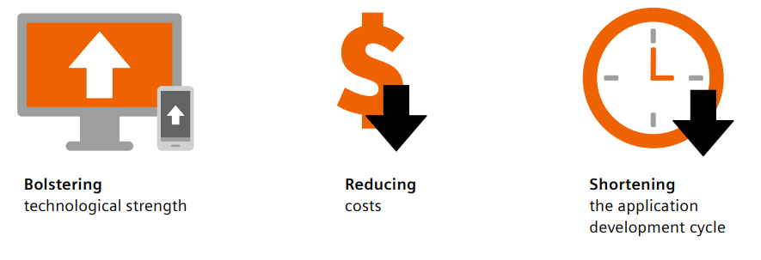
Explain the challenges you faced, and the reason for moving to the cloud
Reasons for moving to cloud:

Slide 6
b. Provide the solution proposed.
Solution was to create an advanced, cloud-based dose management solution – simplifying tasks from data processing to analytics and reporting by using data obtained directly from the imaging modality.
It makes relevant dose data accessible in a convenient manner for entire fleet of radiation-emitting imaging devices including nuclear medicine and its hybrids and all that, vendor independent.
A patient-centric dose monitoring solution where one can view dose values, and all performed examinations for an individual patient but can also drill down to a single scanner or identify protocol settings that need to be improved.
Visualized in a separate alert management page, application makes it easy to detect dose events which exceed institutional or national reference levels, its underlying root cause and thus, facilitates compliance with national regulations.

Slide 7
b. Provide the solution proposed.
On top, it not only ensures interoperability with adjacent applications, but also offers a scalable, complementary, and flexible solution suitable for different levels of dose management excellence that grow with the needs.
Digital solutions require an innovative and flexible software deployment.
This digital health platform offers the flexibility by combining two different deployment models, i.e., cloud and on-edge deployment (software runs on-premises but is operated from the cloud), to enable integrated solutions. Leveraging the benefits of both deployment models is called hybrid computing which is enabled by edge technology.

Slide 8
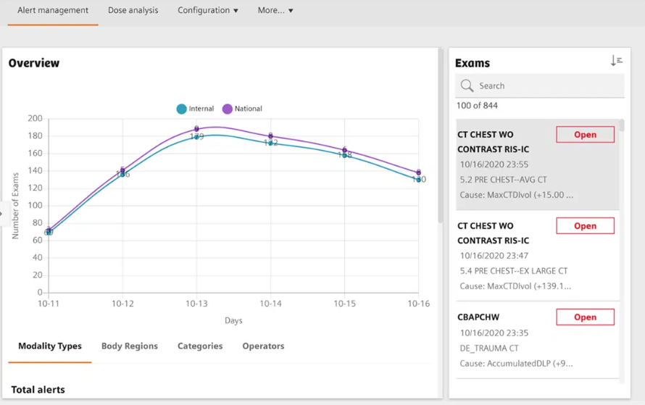
b. Provide the solution proposed.

Slide 9
b. Provide the solution proposed.
What does this application do?
Analysis: Patient-centric dose monitoring, including information from multiple sources, image headers, DICOM Radiation Dose Structured Report (RDSR), and optical character recognition (OCR) on dose report images
In-depth insights: Size-specific dose estimate (SSDE) and effective dose calculation using smart algorithms
Comparison: Benchmark against peers and national and institutional reference levels
Report: Reporting on dose events and storage for future quality assurance.

Slide 10
c. Summarize the benefits post adoption
Data from different modalities, such as CT scanners, angiography and mammography equipment for example can be processed and as it is a cloud-based solution one can have access to data even when they are not close to the imaging device.
The cloud unlocks the potential of all that medical data being generated, thereby making advancements in diagnosis and treatment possible.
Cloud computing can help bring healthcare enterprises into compliance with many regulations, making them more efficient and better able to focus on their mission.
A cloud environment breaks down the silo walls and enables a more holistic view on patient care.

Slide 11
Thank you

